Slide 1
Object Transfiguration with GANs EE 599 Final Project
Haojing Hu, Zheng Wen

Slide 2
Contents
Background
Motivation
Methodology
Implementation
Analysis
Future work
CONTENT | 2

Slide 3
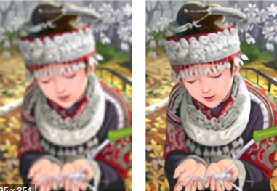
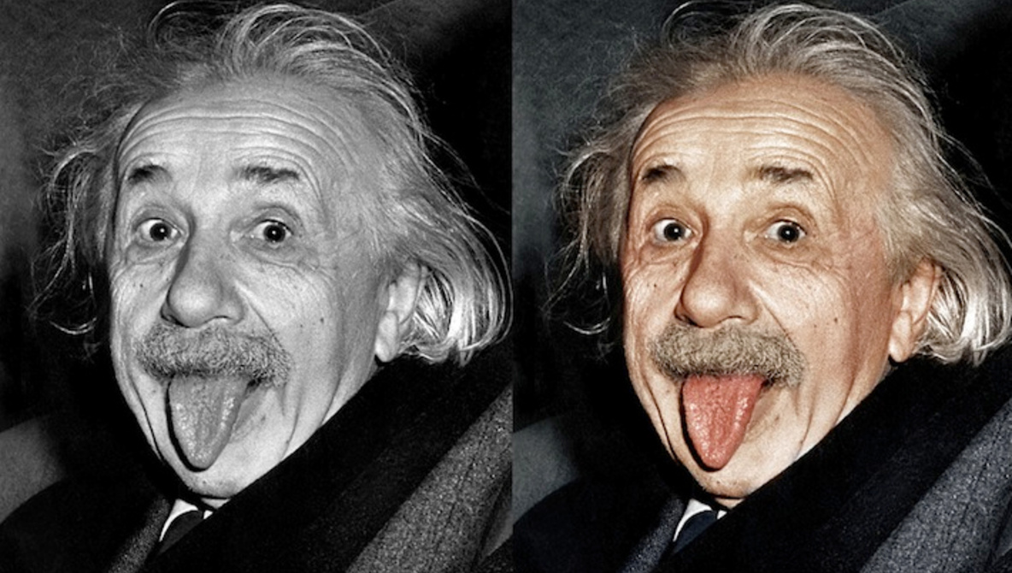
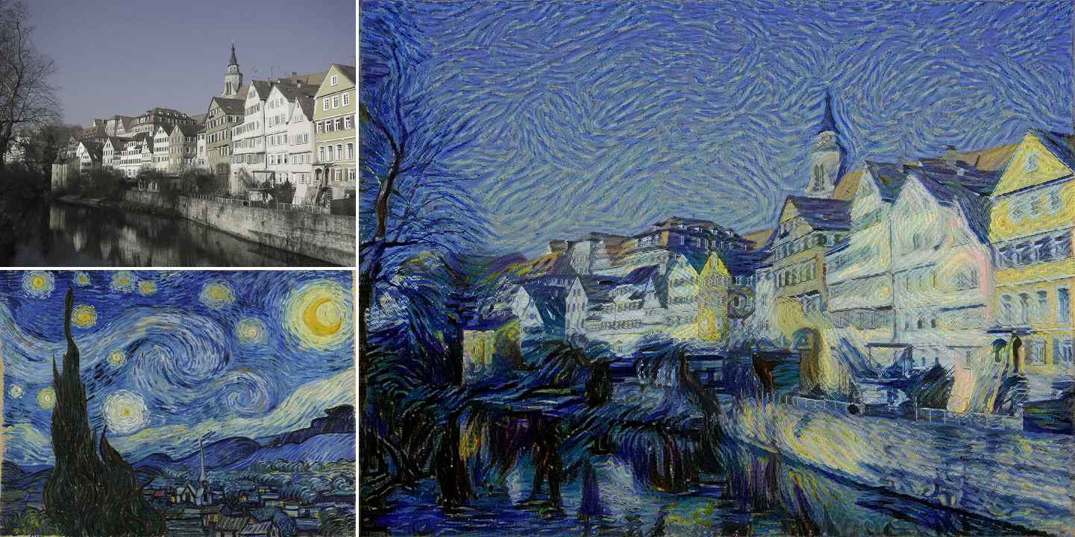
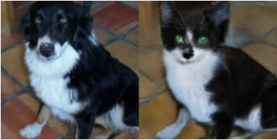
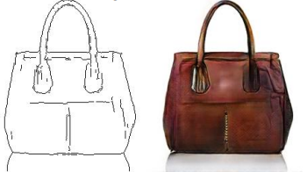
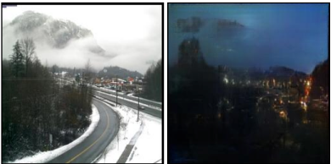
Background
Image translation
Super Resolution
Style Transfer
Image Colorization
Object transfiguration
Edges to Photo
Day to Night
BACKGROUND | 3

Slide 4
Motivation
Difficulty 1: Texture, Color transformation + Shape Deformation
Difficulty 2: Unpaired data
Difficulty 3: Without help of additional information (e.g.
segmentation masks)
MOTIVATION | 4

Slide 5

Methodology
Baseline (CycleGAN)
Identity loss (L1 norm)
Real B
GAN loss
G
Fake B
D
Real A
Real or Fake?
Cycle loss (L1 norm)
Unable to change shape
G
Reconstructed A
D
METHODOLOGY | 5

Slide 6
Methodology
Baseline (GANimorph)
Real B
Feature Matching Loss
LSGAN loss
G
Fake B
D
R/F | R/F | R/F
R/F | R/F | R/F
R/F | R/F | R/F
Real A
Cycle loss (L1 norm + SSIM)
Dilated Convolution
G
Reconstructed A
Cannot well preserve information from real images
D
METHODOLOGY | 6

Slide 7
Methodology
Introduction of losses
SSIM loss (Real A and Reconstructed A) : Close in the structure of image but not necessarily close in exact pixel values
Feature Matching loss (Real B and Fake B) : Force real and fake images from the same domain to have similar features extracted from D
LSGAN loss: Alleviate gradient vanishing in G when D is too powerful
METHODOLOGY | 7

Slide 8
Methodology
Perceptual loss (Style)
Our model
Real B
Perceptual loss (Spatial)
LSGAN loss
G
Fake B
D
R/F | R/F | R/F
R/F | R/F | R/F
R/F | R/F | R/F
Real A
Cycle loss (L1 norm + SSIM)
Dilated Convolution
G
Reconstructed A
D
Gokaslan, Aaron, et al. "Improving shape deformation in unsupervised image-to-image translation." Proceedings of the European Conference on Computer Vision (ECCV). 2018.
METHODOLOGY | 8

Slide 9
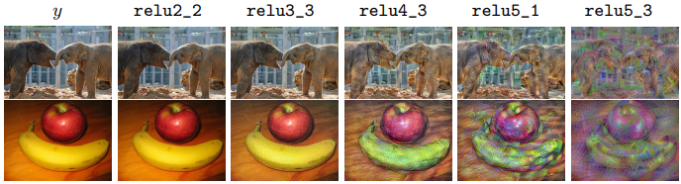
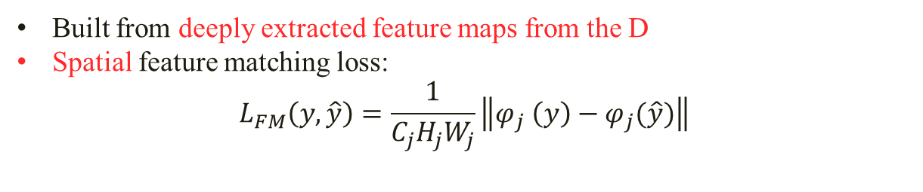
Methodology
Perceptual Loss
Built from deeply extracted feature maps from the D
Spatial feature matching loss:
$$L_{FM}\left(y,\hat{y}\right)=\frac{1}{C_{j}H_{j}W_{j}}\left\|φ_{j} \left(y\right)−φ_{j}(\hat{y})\right\|$$
Shallow
Deep
Johnson, Justin, Alexandre Alahi, and Li Fei-Fei. "Perceptual losses for real-time style transfer and super-resolution." European conference on computer vision. Springer, Cham, 2016.
METHODOLOGY | 9
Notes:
As moving to the deeper layers, image content and overall spatial structure are preserved but color, texture, and exact shape are not.

Slide 10
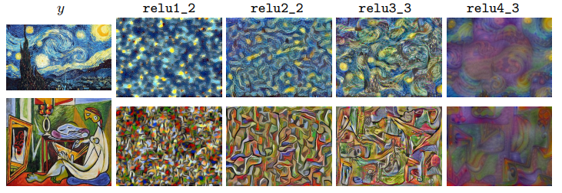
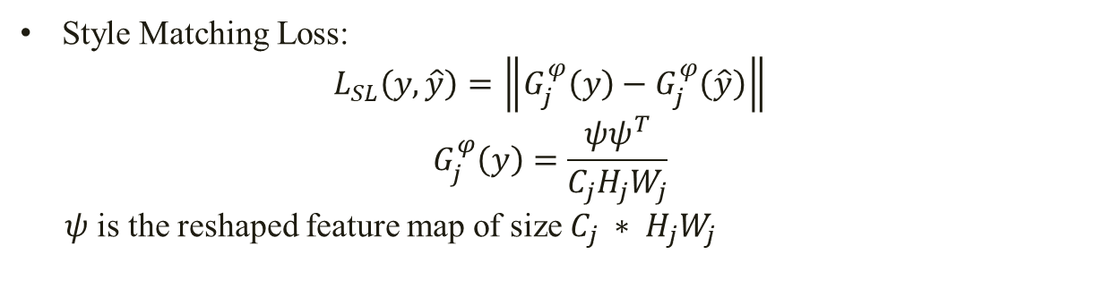
Methodology
Perceptual Loss
Style Matching Loss:
$$L_{SL}\left(y,\hat{y}\right)=\left\|G_{j}^{φ}\left(y\right)−G_{j}^{φ}\left(\hat{y}\right)\right\|$$
$$G_{j}^{φ}\left(y\right)=\frac{ψψ^{T}}{C_{j}H_{j}W_{j}}$$
$ψ$ is the reshaped feature map of size $C_{j} ∗ H_{j}W_{j}$
Shallow
Deep
METHODOLOGY | 10
Notes:
Only preserve the stylistic features, like shape, structure but not the spatial features. As moving deeper, larger-scale structure features are preserved.

Slide 11
Methodology
Share style information(e.g. shape, structure)
Perceptual loss (style)
Baseline (Our model)
Share spatial information(e.g. location, pose)
Real B
Perceptual loss (spatial)
LSGAN loss
G
Fake B
D
R/F | R/F | R/F
R/F | R/F | R/F
R/F | R/F | R/F
Real A
Cycle loss (L1 norm + SSIM)
Dilated Convolution
G
Reconstructed A
D
METHODOLOGY | 11

Slide 12
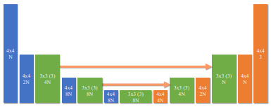
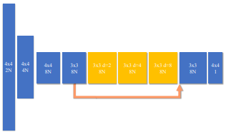
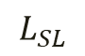
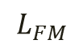
Implementation
Architecture
Generator
Discriminator
$$L_{FM}$$
$$L_{SL}$$
IMPLEMENTATION | 11

Slide 13
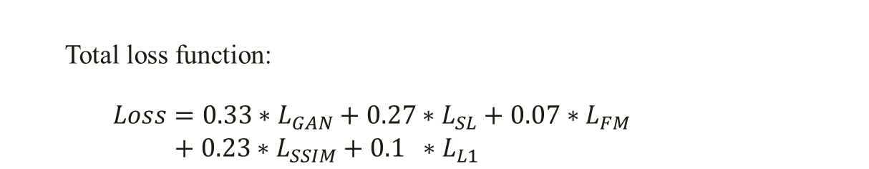
Implementation
Dataset
Cat ⬄ Dog:
Training set: 771 cats, 1264 dogs
Test set: 100 cats, 100 dogs
Data Prepressing
Hyperparameter
Total loss function:
$\begin{matrix} Loss=0.33∗L_{GAN}+0.27∗L_{SL}+0.07∗L_{FM} \\ + 0.23∗L_{SSIM}+0.1 ∗L_{L1} \end{matrix}$
Normalization
40 epochs, 1000 steps / epoch
IMPLEMENTATION | 12
Notes:
Each loss is normalized by its moving average along the training to simplify the adjustment of coefficients

Slide 14
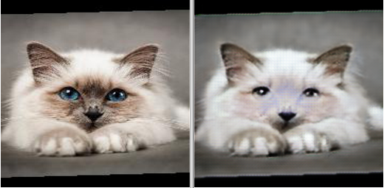
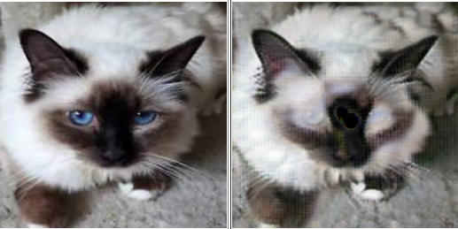
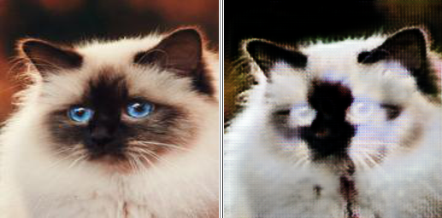
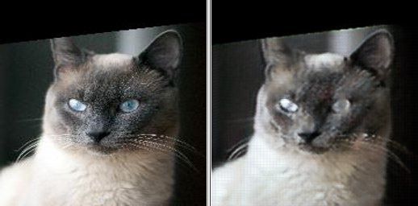
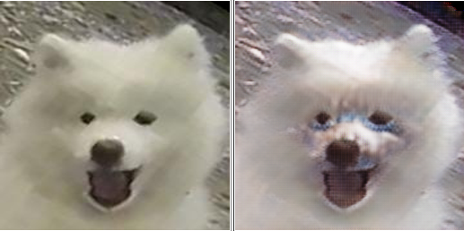
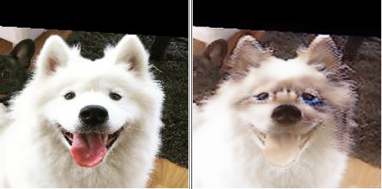
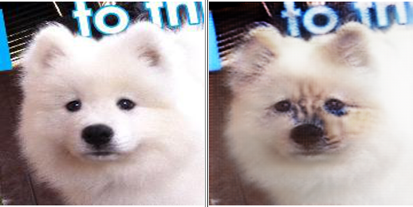
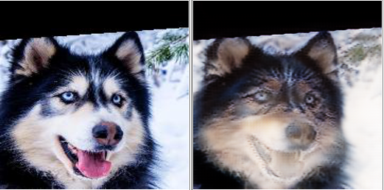
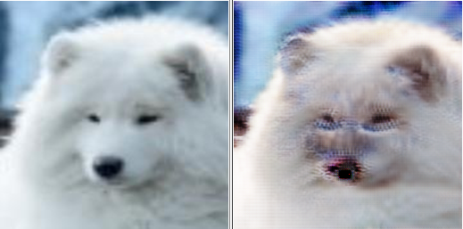
Implementation
Results comparison:
CycleGAN (L: Real R: Generated)
IMPLEMENTATION | 13
Notes:
Complete failed shape changing. Only texture change like contrast and colors.
Because the L1 fixed the shape

Slide 15
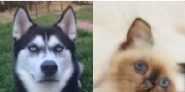
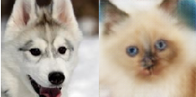
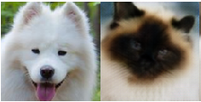
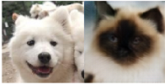
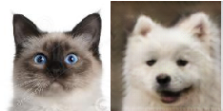
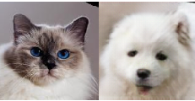
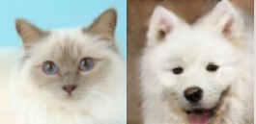
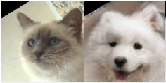
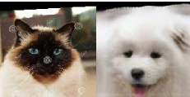
Implementation
Results comparison:
GANimorph (L: Real R: Generated)
IMPLEMENTATION | 14
Notes:
Cannot preserve the location
Cannot preserve the posture, orientation
Low diversity: Husky is mapping to cat with white face and Samoyed is mapping to cat with black face
FM all layers

Slide 16
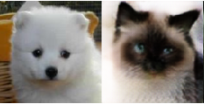
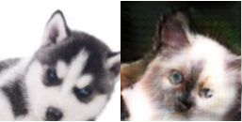
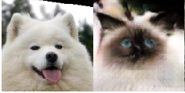
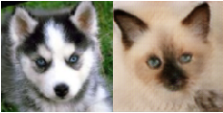
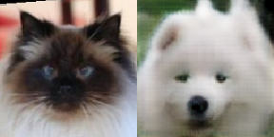
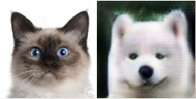
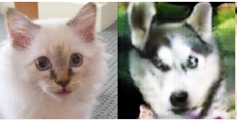
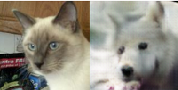
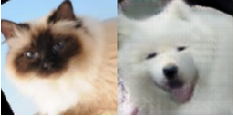
Implementation
Results comparison:
Our model (L: Real R: Generated)
IMPLEMENTATION | 15
Notes:
Preserve the pose
Higher diversity

Slide 17
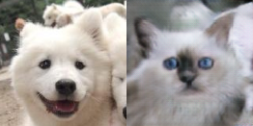
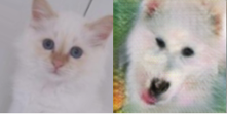
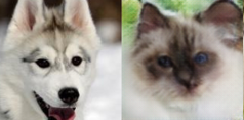
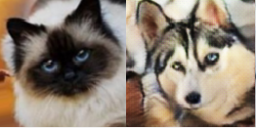
Analysis
Ablation study
Setting 1: SSIM + FM
Style Loss
detail information
ANALYSIS | 16
Notes:
NO SL: detail, twisted mouth, abnormal nose, not lies in the middle of the face
Uncentered nose

Slide 18
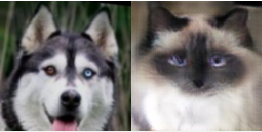
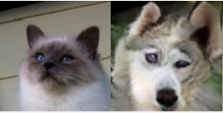
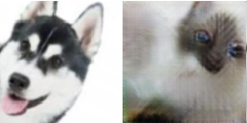
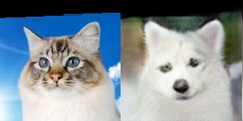
Analysis
Ablation study
Setting 2: SSIM + SL
Feature Matching Loss
location, posture
ANALYSIS | 17
Notes:
Most of them, not parallel, even randomly generalized a face.
Toward left, toward right.

Slide 19




Analysis
Ablation study
Setting 3: FM + SL
SSIM Loss
structure
ANALYSIS | 18
Notes:
Help to recover a basic structure of a face, either loss a eye, or we could not recognize a face at all like fig.3, or the face is twisted.

Slide 20






Analysis
Failure results
Mode Collapse !!
ANALYSIS | 19
Notes:
Mode collapse when we want to continue to train more epochs

Slide 21


Analysis
Reason of Mode Collision
Solutions:
Change the architecture of D and G
Use gradient penalty
Adding adaptive noise
ANALYSIS | 20
Notes:
Mode collapse when we want to continue to train more epochs
D could not learn too faster
Harder to feature out the features and figure out, closer to 100, more noise

Slide 22
Future work
Solving the mode collapse problem
Trying more difficult dataset:
Conduct some quantitative comparison.
FUTURE WORK | 21
Notes:
Mode collapse when we want to continue to train more epochs

Slide 23
Thank you!
22

